Slide 1
RESTful WEB SERVICE

Slide 2
WEB SERVICES

Slide 3
Course Objective
To understand and build a Restful web application using the following
Restful web service
Jersey
JAX-RS
JSON

Slide 4
Reference Link
O'Reilly® RESTful Web APIs (Leonard Richardson, et al)
RESTful Service Best Practices (Todd Fredrich)

Slide 5
Web Service
Web service is a technology to communicate one programming language with another.
Web service provides a way to achieve interoperability.
For example:
Java programming language can interact with PHP and .Net by using web services.

Slide 6
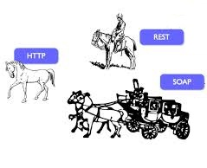
Types of Web Services
Rides directly on HTTP. Plain and simple.
There are mainly two types of web services
SOAP web services.
RESTful web services.
The coach is the soap. It wraps the data to be carried.

Slide 7

SOAP Vs REST
No. | SOAP | REST
1) | SOAP is a protocol. | REST is an architectural style.
2) | SOAP stands for Simple Object Access Protocol. | REST stands for REpresentational State Transfer.
3) | JAX-WS is the java API for SOAP web services. | JAX-RS is the java API for RESTful web services.
4) | SOAP permits XML data format only. | REST permits different data format such as Plain text, HTML, XML, JSON etc.

Slide 8
Web Service API
There are two main API's defined by Java for developing web service applications
1) JAX-WS: for SOAP web services. The are two ways to write JAX-WS application code: by RPC style and Document style.
2) JAX-RS: for RESTful web services. There are mainly 2 implementation currently in use for creating JAX-RS application: Jersey and RESTeasy.

Slide 9
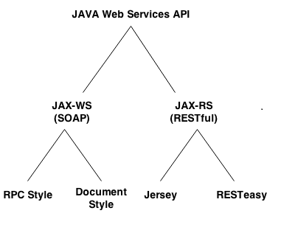
Web Service API

Slide 10
RESTful WEB SERVICE

Slide 11
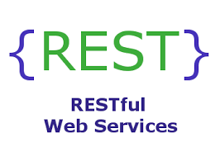
RESTful Web Service
REST is a web standards based architecture and uses HTTP Protocol for data communication.
REST was first introduced by Roy Fielding in year 2000.
REST uses various representations to represent a resource like Text, JSON and XML.

Slide 12
RESTful Resource Class
Resource classes are POJOs
The POJO class or method is annotated with @Path annotation
They are also annotated with @GET, @PUT, @POST, or @DELETE

Slide 13
JAX-RS

Slide 14
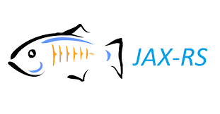
REST with JAX-RS
Developing RESTful Web Services with JAX-RS
The JAX-RS API uses Java programming language annotations to simplify the development of RESTful web services.
Developers decorate Java programming language class files with JAX-RS annotations to define resources
JAX-RS annotations are runtime annotations, runtime reflection will generate the helper classes and artifacts for the resource.

Slide 15
JAX-RS Annotations
Annotation | Description
@Path | The @Path annotation’s value is a relative URI path indicating where the Java class will be hosted: for example, /helloworld.
@GET | The @GET annotation is a request method designator and corresponds to the similarly named HTTP method.
@POST | The @POST annotation is a request method designator and corresponds to the similarly named HTTP method
@PUT | The @PUT annotation is a request method designator and corresponds to the similarly named HTTP method.
@DELETE | The @DELETE annotation is a request method designator and corresponds to the similarly named HTTP method.
@HEAD | The @HEAD annotation is a request method designator and corresponds to the similarly named HTTP method.

Slide 16
JAX-RS Annotation cont…
@PathParam | The @PathParam annotation is a type of parameter that can be extracted for use in the resource class. URI path parameters are extracted from the request URI, and the parameter names correspond to the URI path template variable names specified in the @Path class-level annotation.
@QueryParam | The @QueryParam annotation is a type of parameter that can be extracted for use in your resource class. Query parameters are extracted from the request URI query parameters.
@Consumes | The @Consumes annotation is used to specify the MIME media types of representations a resource can consume that were sent by the client.
@Produces | The @Produces annotation is used to specify the MIME media types of representations a resource can produce and send back to the client: for example, "text/plain".
@Provider | The @Provider annotation is used for anything that is of interest to the JAX-RS runtime, such as MessageBodyReader and MessageBodyWriter.

Slide 17
JERSEY

Slide 18
Jersey
Jersey RESTful Web Services framework is open source, production quality, framework for developing RESTful Web Services
In order to simplify development of RESTful Web services and their clients in Java, a standard and portable JAX-RS API has been designed
Jersey provides it’s own API that extend the JAX-RS toolkit with additional features and utilities to further simplify RESTful service and client development

Slide 19
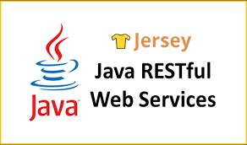
Jersey - Goals
It track the JAX-RS API and provide regular releases of production quality Reference Implementations that ships with GlassFish
Provide APIs to extend Jersey & Build a community of users and developers
Make it easy to build RESTful Web services utilizing Java and the Java Virtual Machine.

Slide 20
JSON

Slide 21
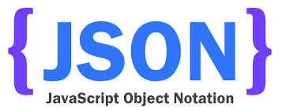
JSON - Introduction
JSON: JavaScript Object Notation.
JSON is lightweight data-interchange format.
JSON is easy to read and write than XML.
JSON is language independent

Slide 22

Uses of JSON
Why to Use JSON?
JSON is a syntax for storing and exchanging data.
JSON uses JavaScript syntax, but the JSON format is text only.
Text can be read and used as a data format by any programming language.
Notes:
Standard Structure: As we have seen so far that JSON objects are having a standard structure that makes developers job easy to read and write code, because they know what to expect from JSON.
Light weight: When working with AJAX, it is important to load the data quickly and asynchronously without requesting the page re-load. Since JSON is light weighted, it becomes easier to get and load the requested data quickly.
Scalable: JSON is language independent, which means it can work well with most of the modern programming language. Let’s say if we need to change the server side language, in that case it would be easier for us to go ahead with that change as JSON structure is same for all the languages.

Slide 23
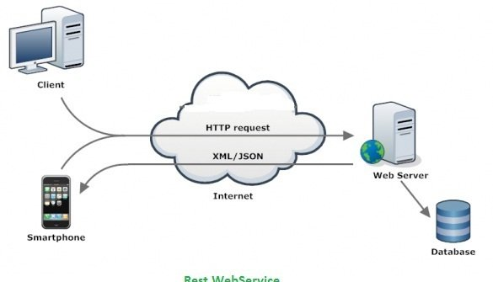
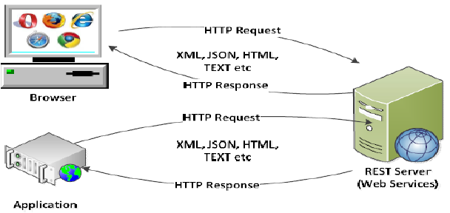
JSON - Architecture

Slide 24
JSON – Data Types
Number
String
Boolean
Array
Object
Null

Slide 25
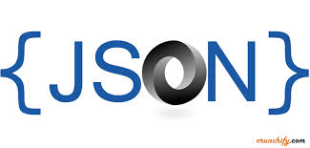
JSON - Syntax
{
“Name”:”Thomas”,
“Age”:22,
“address”:{
“street”:”5th street”,
“city”:”Chennai”};
}
Data is represented in name/value pairs.
Curly braces hold objects and each name is followed by ':'(colon), the name/value pairs are separated by , (comma).

Slide 26
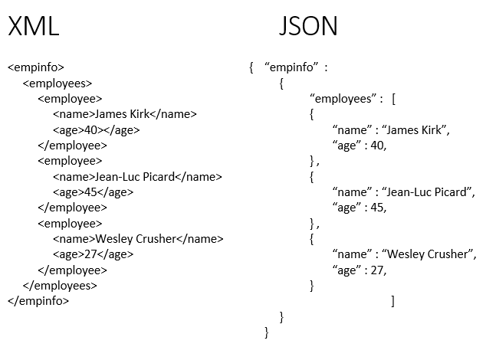
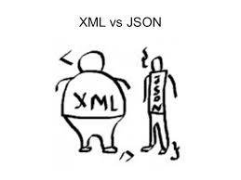
JSON Vs XML

Slide 27
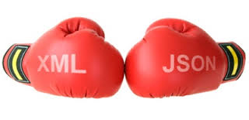
JSON Vs XML
1) | JSON is data-oriented. | XML is document-oriented.
2) | JSON doesn't provide display capabilities. | XML provides the capability to display data because it is a markup language.
3) | JSON supports array. | XML doesn't support array.
4) | JSON files are more human readable than XML. | XML files are less human readable.
5) | JSON supports only text and number data type. | XML support many data types such as text, number, images, charts, graphs etc. Moreover, XML offeres options for transferring the format or structure of the data with actual data.

Slide 28
JSON - Object
JSON object holds key/value pair.
Each key is represented as a string in JSON and value can be of any type.
The keys and values are separated by colon.
Each key/value pair is separated by comma.
{
"employee": {
"name": “Harry",
"salary": 56000,
"married": true
}
}

Slide 29
JSON - Array
JSON array represents ordered list of values.
JSON array can store multiple values.
It can store string, number, boolean or object in JSON array.
{"employees":[
{"name":"Ram", "email":"ram@gmail.com", "age":23},
{"name":"Shyam", "email":"shyam23@gmail.com", "age":28},
{"name":"John", "email":"john@gmail.com", "age":33},
{"name":"Bob", "email":"bob32@gmail.com", "age":41}
]}

Slide 30
JSON - Demo
Create a file JsonDemo
Save the file as JsonDemo.htm

Slide 31
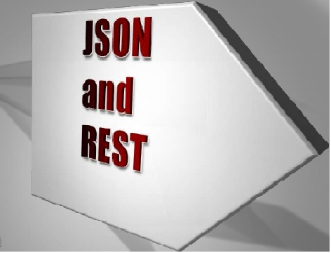

Slide 32
Rest with Jersey, JAX-RS and Json
STEP 1:
Create a Web project
STEP 2:
Convert the Web project into Maven project
Right click the Web project-> Configure ->Convert to Maven Project

Slide 33
Rest with Jersey, JAX-RS and Json Cont…
STEP 3:
Add the following Servlet data in the Web.xml file
<servlet> <servlet-name>jersey-serlvet</servlet-name> <servlet-class>org.glassfish.jersey.servlet.ServletContainer</servlet-class> <init-param> <param-name>javax.ws.rs.Application</param-name> <param-value>com.Hexa.RestService.FTPApplication</param-value> </init-param> <init-param> <param-name>jersey.config.server.tracing</param-name> <param-value>ALL</param-value> </init-param> <load-on-startup>1</load-on-startup> </servlet> <servlet-mapping> <servlet-name>jersey-serlvet</servlet-name> <url-pattern>/api/*</url-pattern> </servlet-mapping>

Slide 34
Rest with Jersey, JAX-RS and Json Cont…
STEP 4:
Add the following dependencies in Pom.xml
<dependency> <groupId>com.sun.jersey</groupId> <artifactId>jersey-json</artifactId> <version>1.8</version> </dependency> <!-- https://mvnrepository.com/artifact/org.glassfish.jersey.media/jersey-media-json-jackson --> <dependency> <groupId>org.glassfish.jersey.media</groupId> <artifactId>jersey-media-json-jackson</artifactId> <version>2.3.1</version> </dependency>

Slide 35
Rest with Jersey, JAX-RS and Json Cont…
<dependency> <groupId>org.glassfish.jersey.core</groupId> <artifactId>jersey-server</artifactId> <version>2.26</version> </dependency> <!-- https://mvnrepository.com/artifact/org.glassfish.jersey.containers/jersey-container-servlet --> <dependency> <groupId>org.glassfish.jersey.containers</groupId> <artifactId>jersey-container-servlet</artifactId> <version>2.26</version> </dependency>

Slide 36
Rest with Jersey, JAX-RS and Json Cont…
STEP 5:
Create a java class “DataCenter.java”
Annotate the class with @Path() annotation
@Path("data")
public class DataCenter {}
3. Create a method and annotate it with
@Produce():annotation is used to specify the MIME media types or representations a resource can produce and send back to the client
@GET:The HTTP GET method is used to read (or retrieve) a representation of a resource.

Slide 37
Rest with Jersey, JAX-RS and Json Cont…
4. @PathParam: It is used to inject the value of URI parameter that defined in @Path expression, into Java method.
@GET //@Produces(MediaType.TEXT_HTML) @Produces(MediaType.APPLICATION_JSON) @Path("{name}") public String getMsg(@PathParam("name") String name) { String output = "Welcome to Web world: " + name; System.out.println(output); return output; }

Slide 38
Rest with Jersey, JAX-RS and Json Cont…
STEP 6:
CORSFilter: Cross Origin Resource Sharing
CORS is a mechanism supported by W3C to enable cross origin requests in web-browsers
It requires support from both browser and server to work
This is a Java Jersey Web Server filter implementation of server-side CORS for web containers such as Apache Tomcat and other Embedded Web Servers

Slide 39
Rest with Jersey, JAX-RS and Json Cont…
CORSFilter Code:
public void filter(ContainerRequestContext request,
ContainerResponseContext response) throws IOException {
response.getHeaders().add("Access-Control-Allow-Origin", "*");
response.getHeaders().add("Access-Control-Allow-Headers",
"origin, content-type, accept, authorization");
response.getHeaders().add("Access-Control-Allow-Credentials", "true");
response.getHeaders().add("Access-Control-Allow-Methods",
"GET, POST, PUT, DELETE, OPTIONS, HEAD");
}
}

Slide 40
Rest with Jersey, JAX-RS and Json Cont…
STEP 7:
Start the Tomcat Server in GIT bash
1. Open GIT bash
2.Specify the location of Tomcat in GIT bash
3. Execute the following command,
A. To shutdown the Tomcat Server
$./bin/shutdown.sh
B. To Start the Tomcat Server
$./bin/startup.sh
C. To view the logs
$ tail –f logs/*

Slide 41
Rest with Jersey, JAX-RS and Json
STEP 8:
Open another GIT bash to Execute the rest service
1. mvn package
2. cp target/RestWeb-0.0.1-SNAPSHOT.war C:\Users\31410\Desktop\apache-tomcat-8.5.16-windows-x64\apache-tomcat-8.5.16
3. curl -vvv "http://localhost:8886/RestWeb-0.0.1-SNAPSHOT/api/data/Thomas"

